Slide 1



Information available in audio.
PROJECT PRESENTATION
PRESENTED BY
Group 14 Harikrishna Surabhi Jitin Naidu Kondipati Kishore Kumar Suresh Shrey Sandeep Jain
Vikram Ratan
Unraveling Chicago's Crime Dynamics

Slide 2

Introduction
The "Crimes - 2001 to present - Dashboard" dataset is a comprehensive collection of reported crime incidents in the city of Chicago, Illinois, USA, from 2001 to the present. This dataset is maintained by the Chicago Police Department and regularly updated to reflect the most recent information. The data is sourced from the city's CLEAR (Citizen Law Enforcement Analysis and Reporting) system. Utilizing the "Crimes - 2001 to present - Dashboard" dataset, we dive into various aspects of crime, including spatial and temporal characteristics, crime types, and arrest rates.
https://data.cityofchicago.org/Public-Safety/Crimes-2001-to- present-Dashboard/5cd6-ry5gt

Slide 3

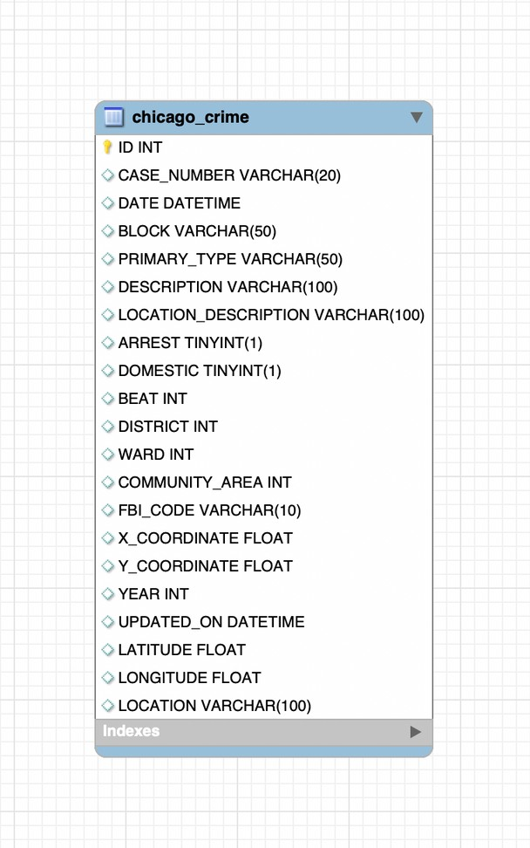
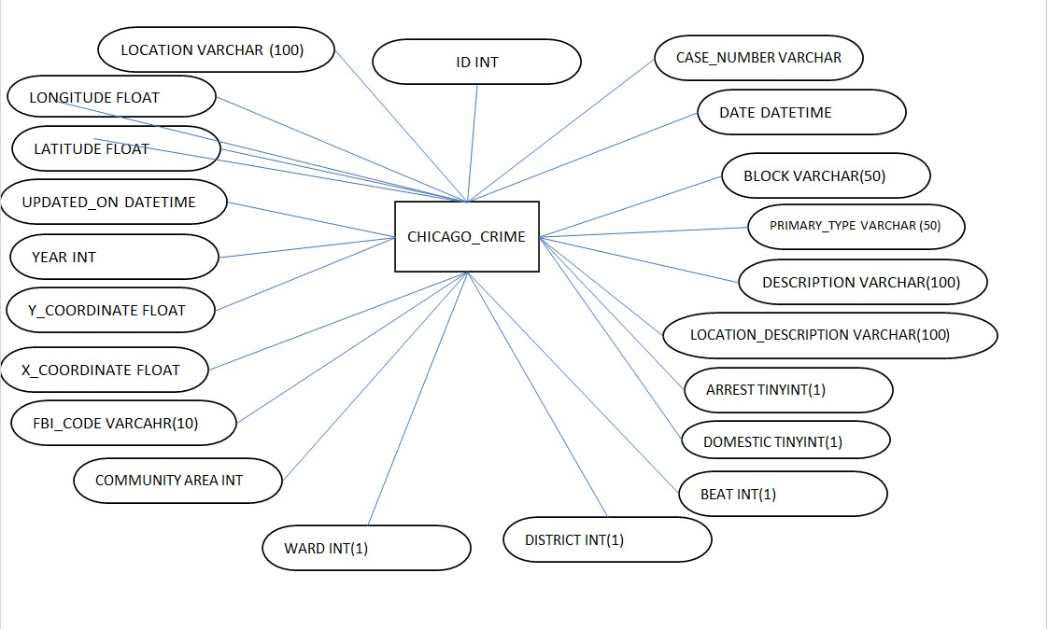
CONCEPTUAL DESIGN AND LOGICAL DESIGN

Slide 4
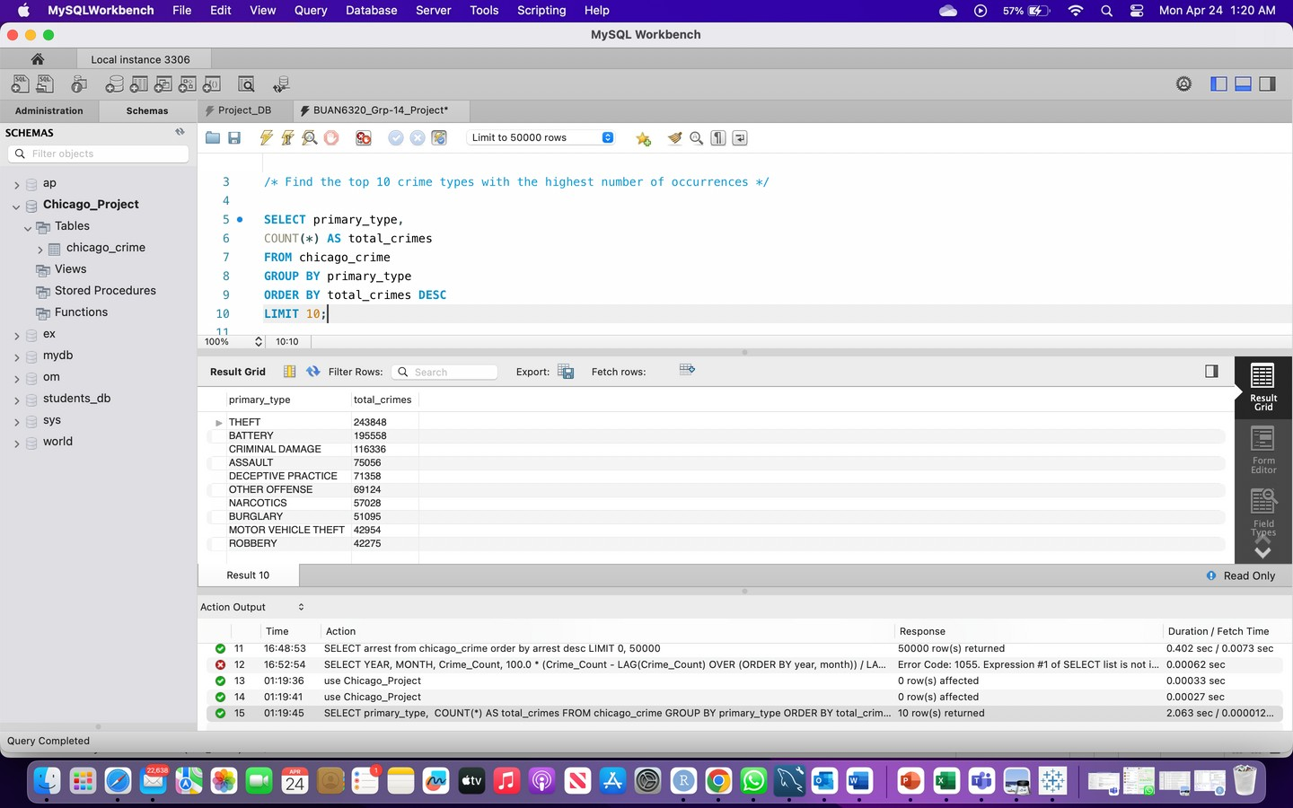
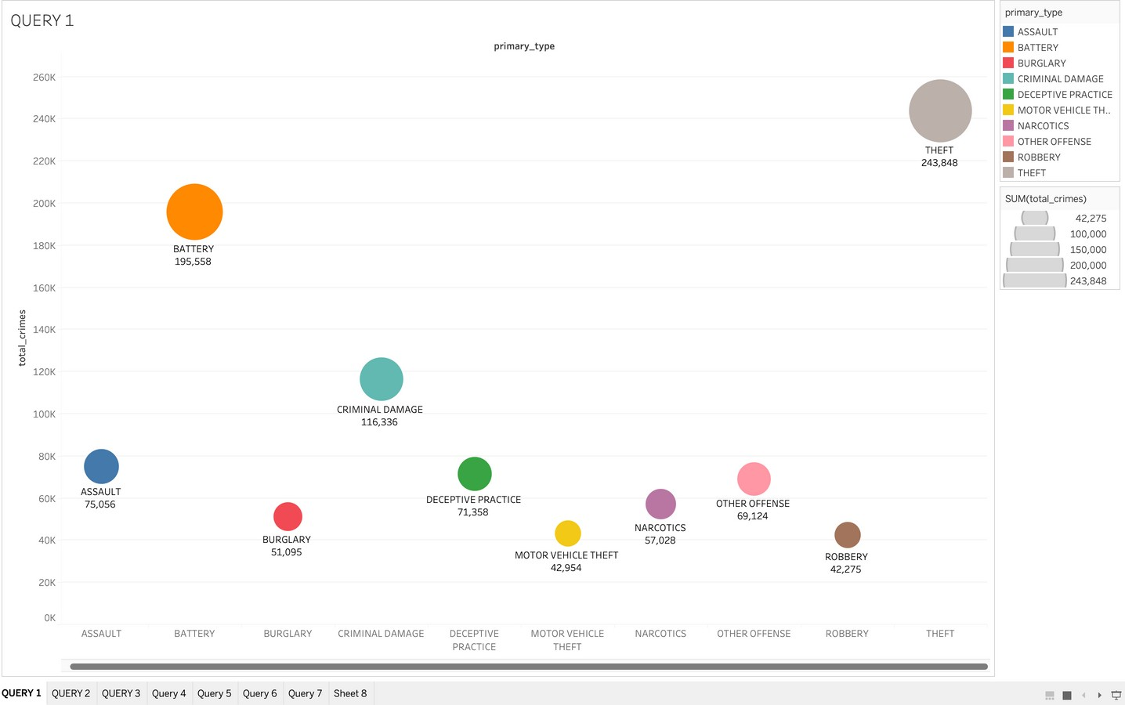
INSIGHT-1
We observerd the top 10 types of crime in Chicago where theft and battery crimes were the highest.

Slide 5

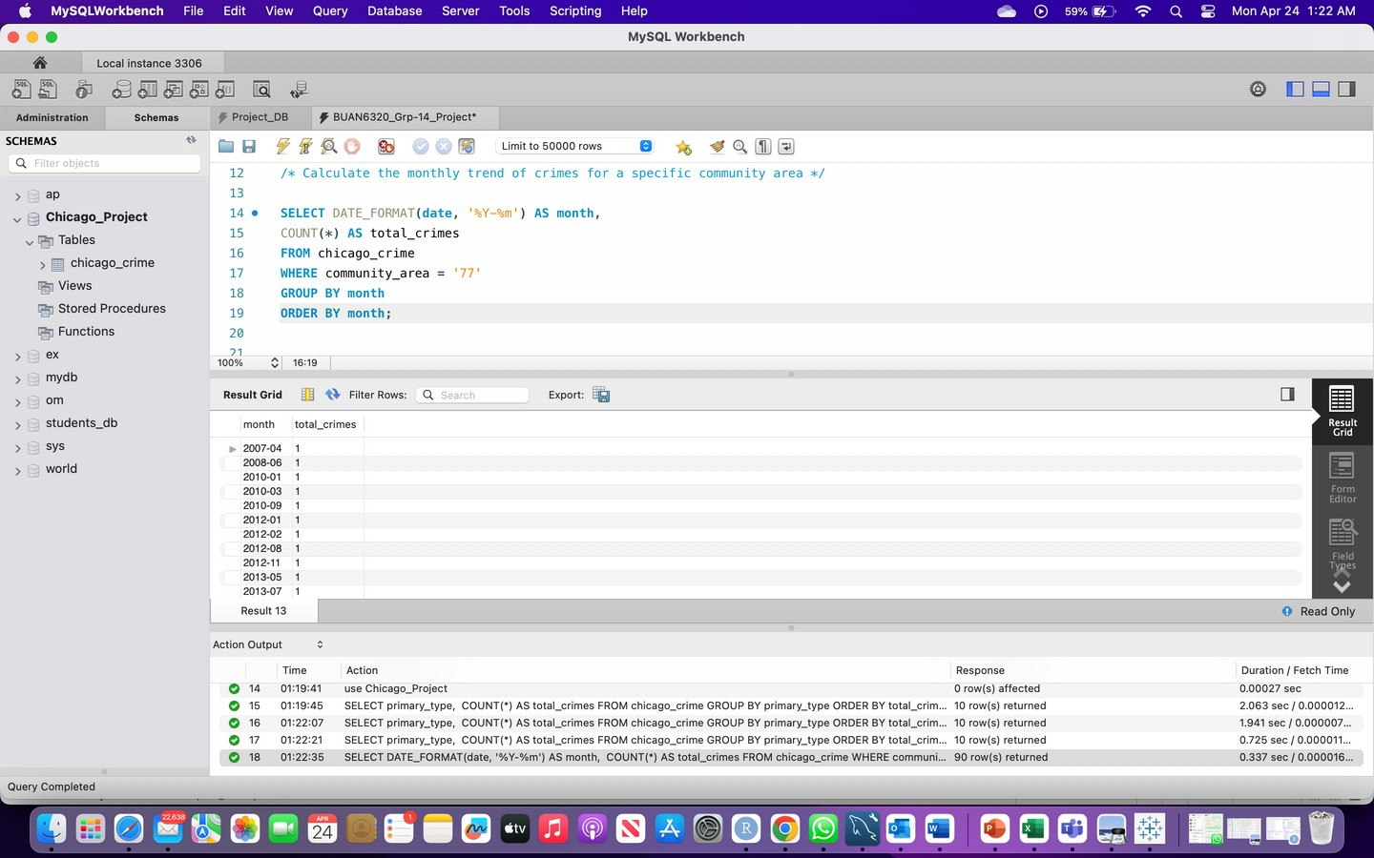
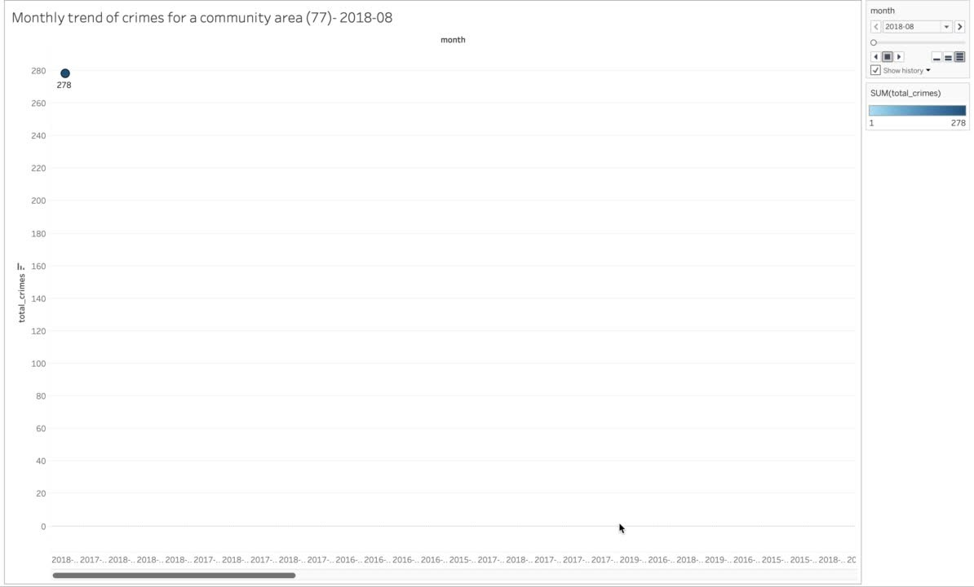
INSIGHT-2
This line graph depicts the monthly trend of crimes in a specific community. We can observe that there is a declining trend.

Slide 6

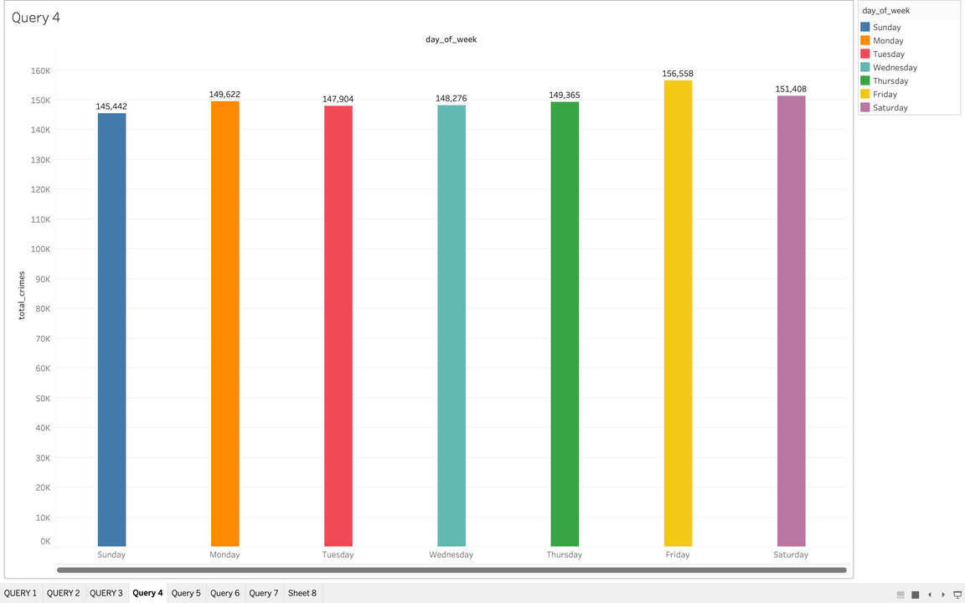
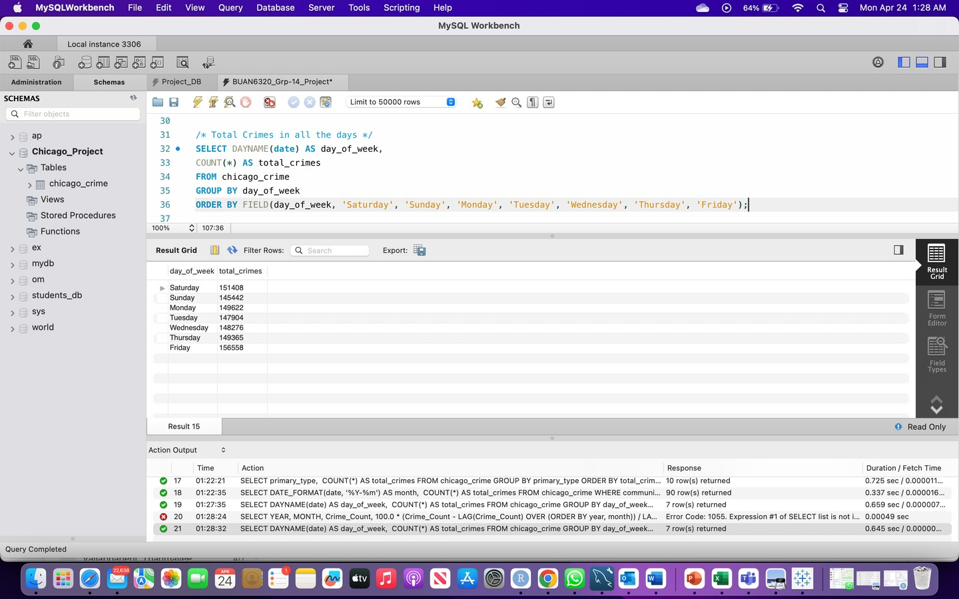
INSIGHT-3
The total number of crimes per day are approximately uniformly distributed with thursday having the highest crimes.

Slide 7

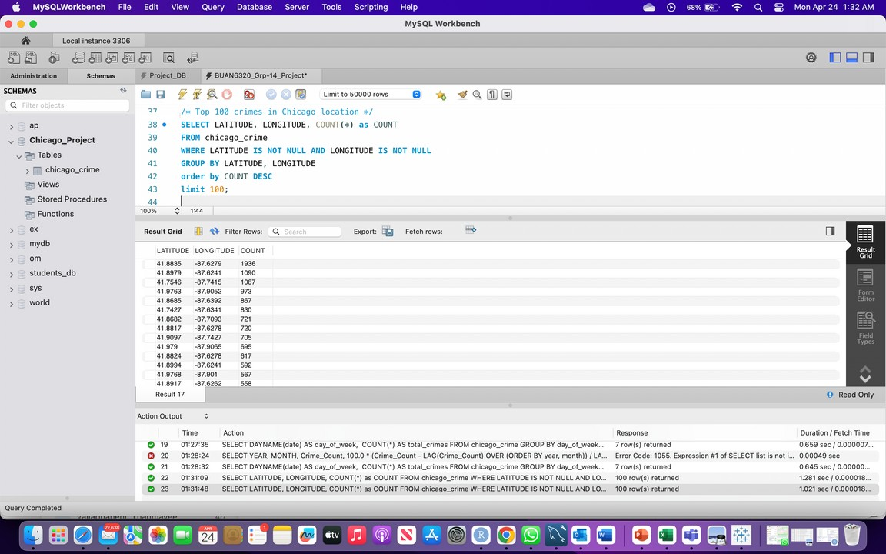
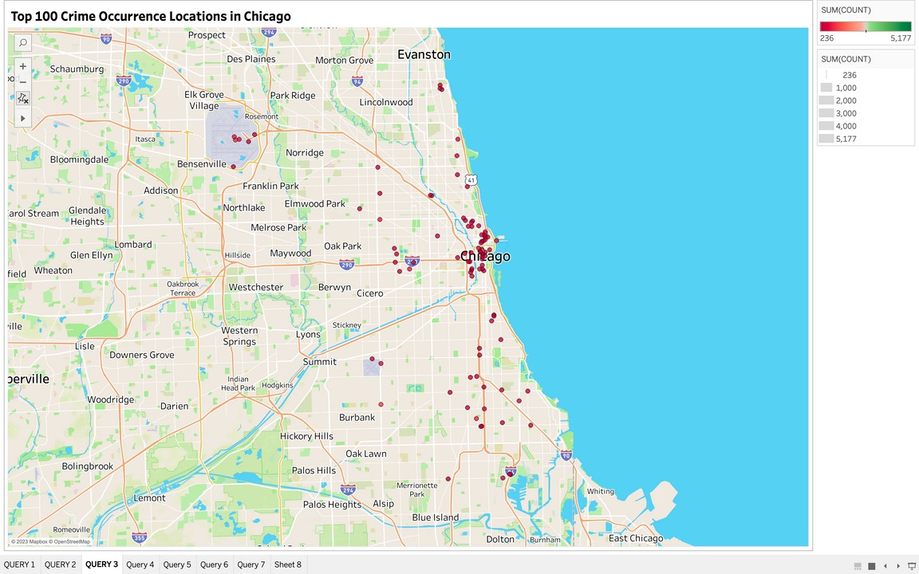
INSIGHT-4
A spatial representation of top 100 locations that have the highest crimes in and around the Chicago city

Slide 8
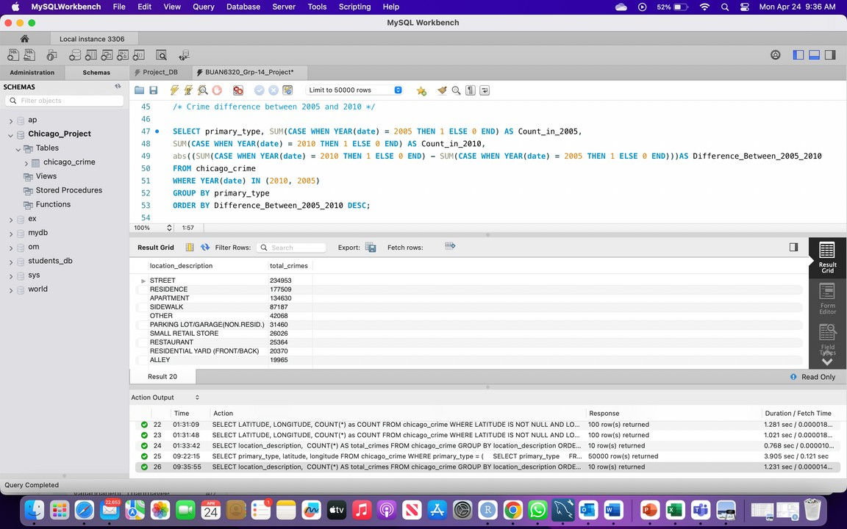
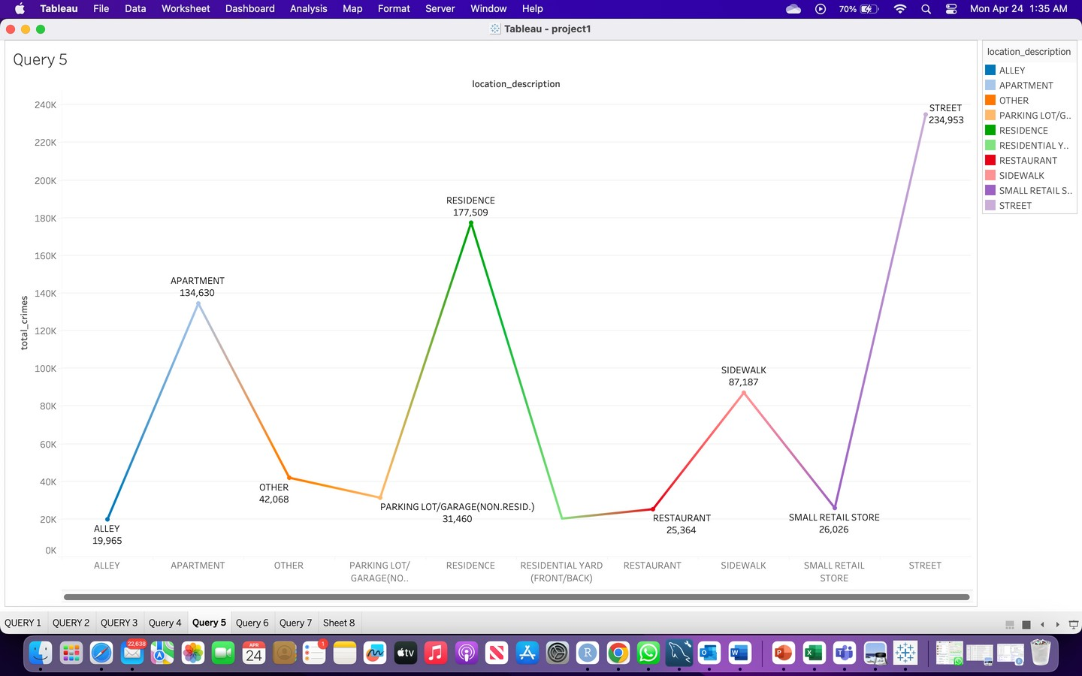
INSIGHT-5
line graph visualizes the type of location which has the highest crimes.

Slide 9

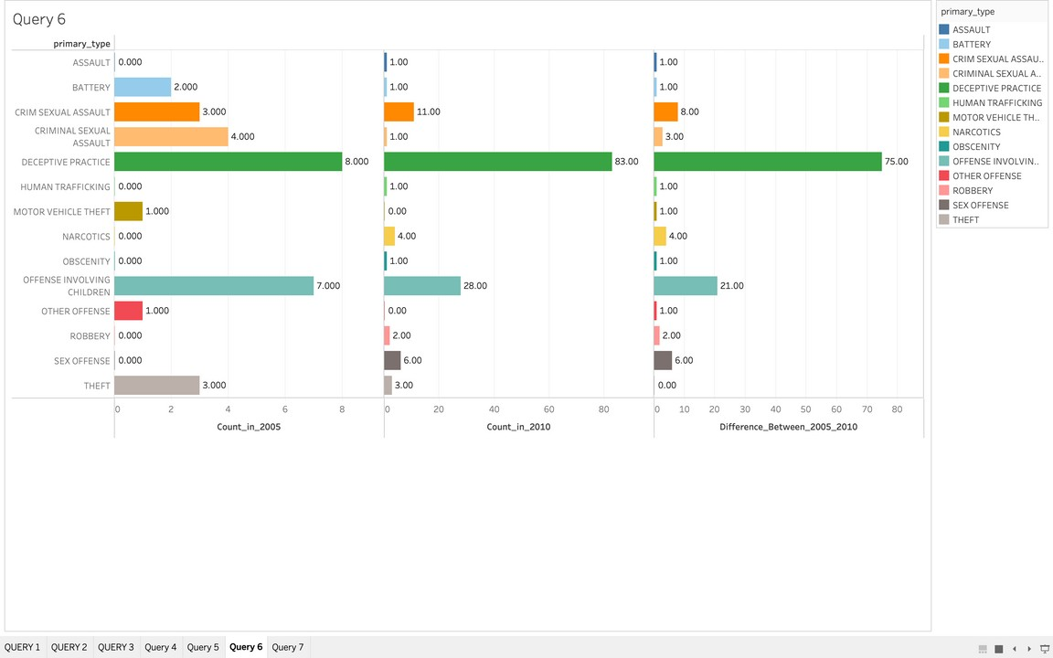
INSIGHT-6
Graphical representation of difference in crime types in the years 2005 and 2010

Slide 10
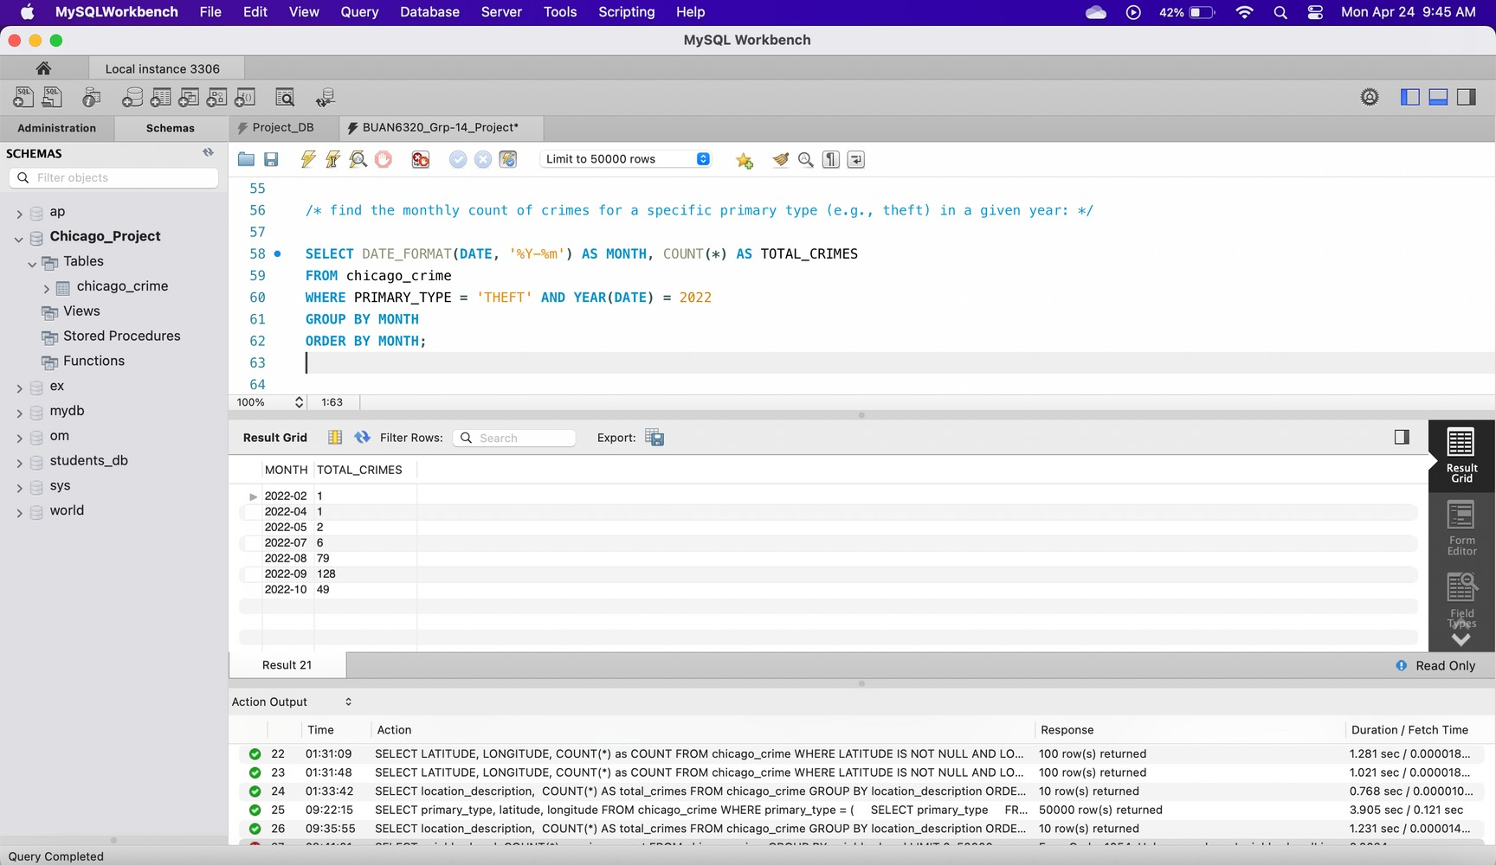
INSIGHT-7
September month having the highest theft rate in the year 2022

Slide 11

INSIGHT-8
Top 10 communties having the highest number of reported crimes

Slide 12
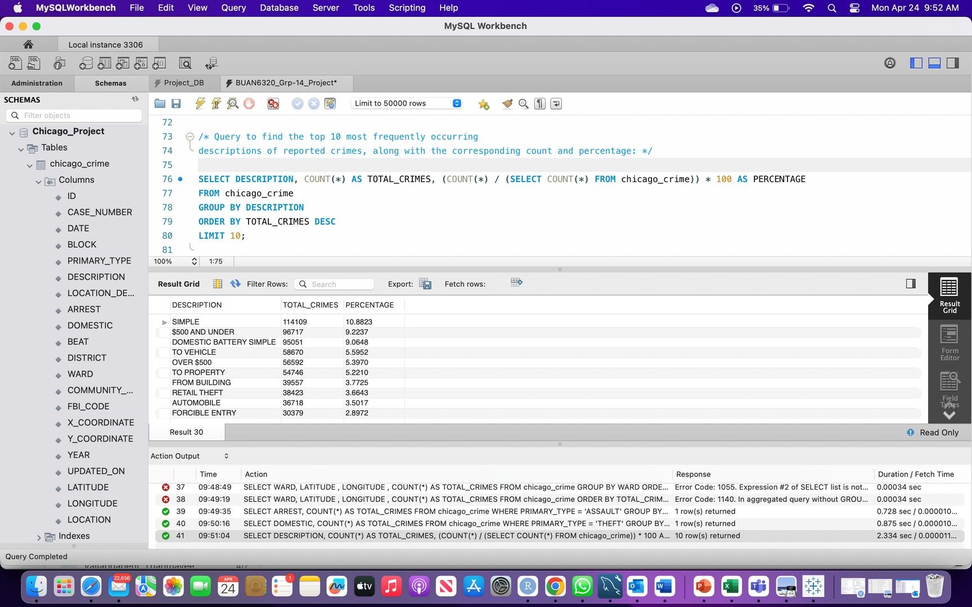
INSIGHT-9
Top 10 most frequently occuring description of crimes with respective count and percentage

Slide 13
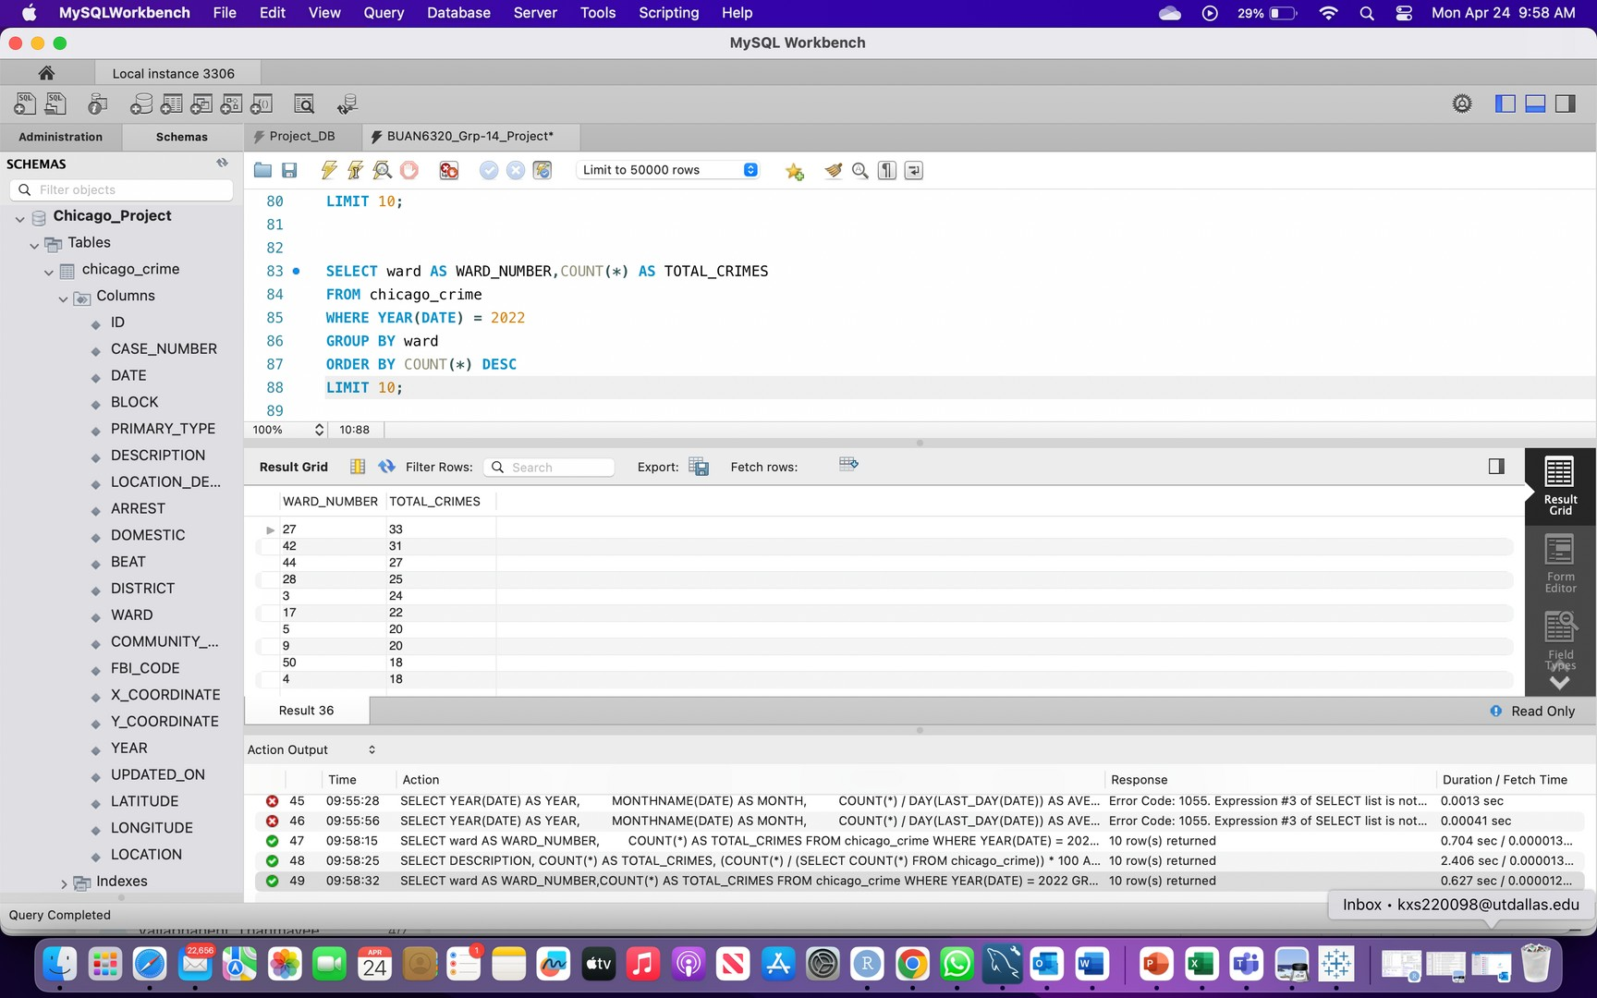
INSIGHT-10
Top 10 wards having the highest crimes in the city.

Slide 14
THANK YOU

